Slide 1
Measures of position
Z- scores, percentiles, quartiles, interquartile range

Slide 3
Measures of position refer to standardizing and comparing values to a set of data, so we can better understand their position.
To define and compare position we use the following indicators:
Z – scores;
Percentiles, quartiles, deciles and the interquartile range.

Slide 4
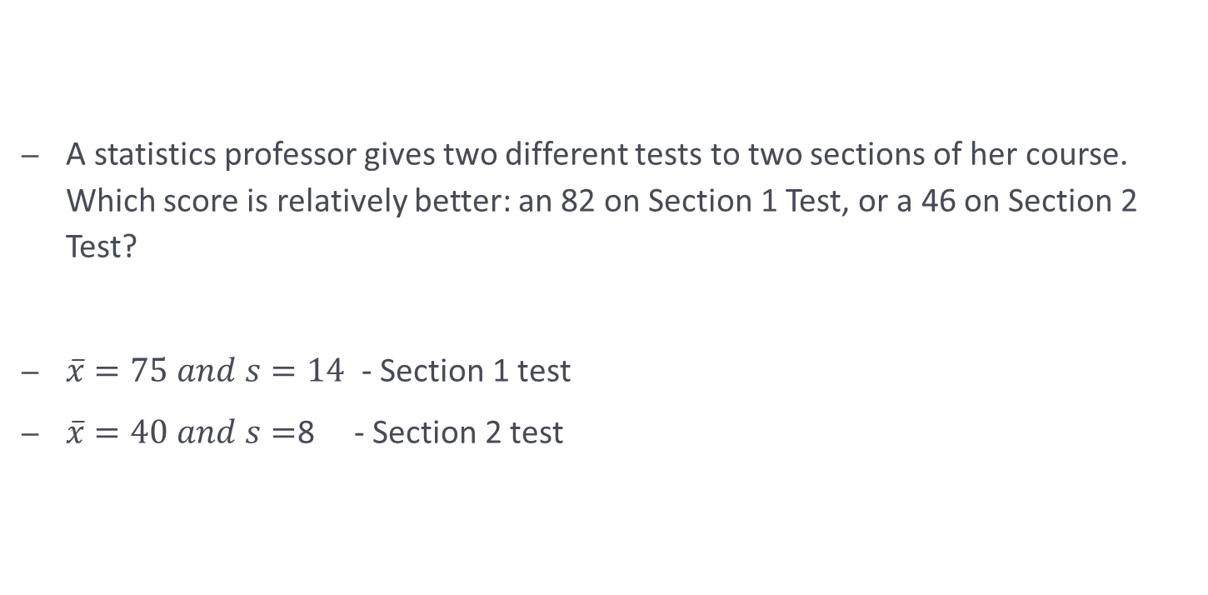
Which is better?
A statistics professor gives two different tests to two sections of her course. Which score is relatively better: an 82 on Section 1 Test, or a 46 on Section 2 Test?
$\overline{x}=75 and s=14$ - Section 1 test
$\overline{x}=40 and s=$8 - Section 2 test

Slide 5


To make a decision we need to express both scores relative to their means, so that we can compare them.
The z-score or the standard score is the number of standard deviations of a certain value x is above or below the mean.
We use different formulae for calculating the standard score for populations and for samples.
For a population:
For a sample:
$$z= \frac{x − μ}{σ}$$
$$z= \frac{x − \overline{x} }{s}$$

Slide 6
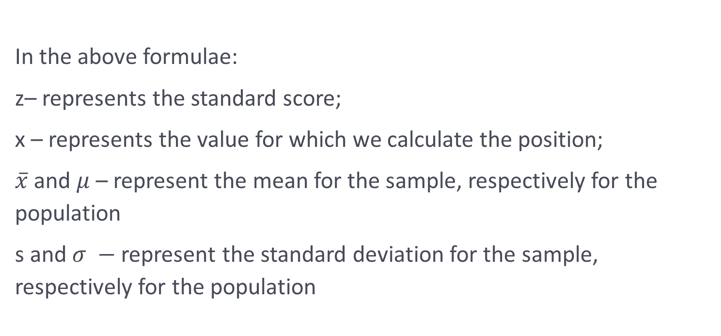
In the above formulae:
z– represents the standard score;
x – represents the value for which we calculate the position;
$\overline{x}$ and $μ$ – represent the mean for the sample, respectively for the population
s and $σ −$represent the standard deviation for the sample, respectively for the population

Slide 7


The standard score – comparing to the mean
In order to be able to compare the 2 scores, we need to compute a standard score, that will indicate the position with respect to the mean.
For the first test, we get:
$z= \frac{x − \overline{x} }{s}$ = 0.50
For the second test, we get:
Conclusion?
$z= \frac{x − \overline{x} }{s}$ = 0.75

Slide 8
Percentiles, quartiles and deciles
A percentile measure the position of a single data item based on the percentage of data items below that single data item.
If approximately n percent of the items in a distribution are less than the number x, then x is the nth percentile of the distribution, denoted P_{n}.

Slide 9
Example. Find the 40th percentile
The following are test scores (out of 100) for a particular math class.
44 56 58 62 64 64 70 72 72 72 74 74 75 78 78 79 80 82 82 84 86 87 88 90 92 95 96 96 98 100
Find the percentile’s position, using the formula:
1) If (k/100)n is a whole number, then
Location of P_{k} = (k/100)n + 0.5
2) If (k/100)n is not a whole number, then
Location of P_{k} is the next higher whole number
The average of the 12th and 13th items represents the 40th percentile (P₄₀).
40% of the scores were below 74.5.

Slide 10
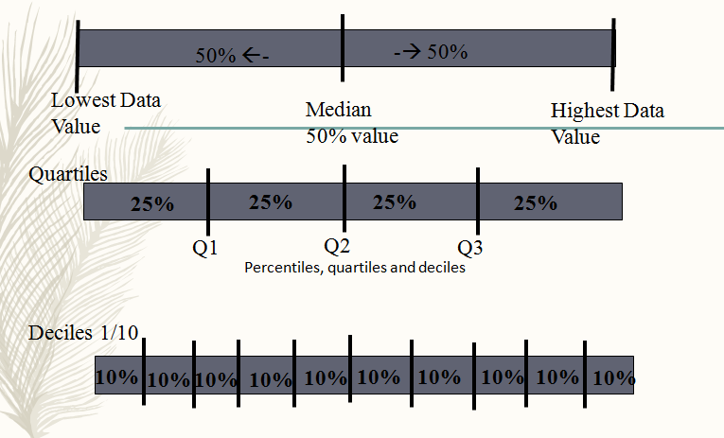
Percentiles, quartiles and deciles

Slide 11
Example
Given the following data, find the quartiles and the 88th percentile:
2, 5, 8, 6, 7, 5, 9, 3, 9, 4, 1

Slide 12
Solution
Order the values:
Find the median of the data (Q₂) =
Find the first quartile (Q₁) =
Find the third (Q₃) =
What number is at the 88th percentile?
1, 2, 3, 4, 5, 5, 6, 7, 8, 9, 9
5
3
8
9

Slide 13
Interpreting the IQR
The interquartile range is the difference between the third and the first quartile:
IQR = Q3 – Q1
IQR shows the range for the middle half of the data. It is not sensitive to outliers.

Slide 14
Outlier
A value that is much greater or much less than the median
Data that are more than 1.5 times (mild outlier) the value of the interquartile range beyond the quartiles (above the third quartile or below the first quartile)
Data that are more than 3.0 times (severe outlier) the value of the interquartile range beyond the quartiles (above the third quartile or below the first quartile)

Slide 15
Example:
Find any outliers for the data in the table.
Country | Chocolate Sales (in billion dollars)
United States | 16.6
United Kingdom | 6.5
Germany | 5.1
Russia | 4.9
Japan | 3.2
France | 2.1
Brazil | 2.0
Locate the median, third quartile, and first quartile.
b) Interquartile Range = 6.5 - 2.1 = 4.4
c) Multiply the interquartile range by 1.5. 4.4(1.5) = 6.6
d) Find the limits for the outliers.
-Subtract 6.6 from first quartile.
2.1 – 6.6 = -4.5 lower limit
-Add 6.6 to the third quartile.
6.5 + 6.6 = 13.1 upper limit
Third Quartile
Median
First Quartile
e) The only outlier is 16.6 since that value is above the upper limit.

Slide 17
Practice
Find the median, upper and lower quartiles, interquartile range and any outliers for the following data set:
81, 79, 88, 67, 89, 87, 85, 83, 83

Slide 20
Practice
1. The data represents the lengths of 2 years old trees (in inches) recorded at a nursery.
75 94 95 98 99 103 103 104 106 156
a) Find the median.
b) Find the third quartile, Q₃.
c) Find P_{25.}
d) Does the data contain any outliers? Justify your answer.

Slide 22
2. The mean of the students' scores on a test is 86%. The standard deviation is 11.2%.
a) Find the z-score for a test score of 65%.
b) What score would be 1.25 standard deviations above the mean?

Slide 24
3. The heights of trees in a nursery have a mean of 6.5 inches, with a standard deviation of 1.7 inches. Find the z-score for the following heighs:
a) 10.0 inches
b) What height would be 1.85 standard deviations below the mean?

